Slide 1
IEEE Central Texas Section 2019 Fall Leadership Planning Meeting August 24, 2019 San Marcos, TX
Section Committee/Officer Name: Andrew Bluiett
Chapter/Affinity Name: (PI)^2 = PE31/IE13/PEL35/IA34
Prepared by: Andrew Bluiett

Slide 2
Vision, Leadership Team
OU Name: Central Texas Section, PE31/PEL35/IE13/IA34 Austin (PI)^2
Mission/2019 Focused Initiatives*
To become the most valued professional affiliation for engineers engaged in power, energy and industrial electronics
Leadership Team
Position Name Email
Chair Andrew Bluiett, P.E. andrew.bluiett@iee.org
Vice Chair Marcie Gard, P.E. marciegard@ieee.org
Treasurer James Mercier, P.E. james.mercier@ieee.org
Secretary/vTools Ruth Sulzer, P.E. ruth.sulzer@ieee.org
Communication Martha Dodge martha.dodge@ieee.org
Webmaster David Heatherington david.heatherington@ieee.org
Program Eric Meier eric.meier@ieee.org
Member at large Dr. Hao Zhu hao.zhu@ieee.org
Member at large Franklin Bohac, P.E. franklin.bohac@ieee.org
Past Chair/Utility Steve Pearson steve@pearsonstrategy.com
Past Chair/Awards Kris Dehnel kris.dehnel@ieee.org
(PI^2) Joint Chapter (24 IES, 71 PEL, 73 IAS, 333 PES)
.

Slide 3
2019 Key Accomplishments
(PI)^2
Established attractive and functional venue (Cover 3) for tech meetings which attracts a different population in North Austin. Established relationship with Scottish Rite Theatre for workshops.
1 Professional Development Meeting
8 Tech Meetings
2 Tours (Celebrated PELS Day at Techo Westinghouse)
1 Workshop (Celebrated 55 years as IAS Chapter.. Oldest Chapter)
1 Award Meeting (OEA +15, -15, OVA)
8 Admin Meetings (Set a new time and date acceptable to ChapComm)
16 Newsletters
291 total attendance at our tech/workshop meetings
71 total attendance at our chapcomm meetings
Earned high performing PES chapter award
Earned Outstanding PES chapter award
Earned Outstanding IES chapter award
Recognized PES outstanding engineers and volunteer

Slide 4
2019 Technical Meetings / Tours

Slide 5
2019 Chapter Vitality
Chapter Vitality Assessment
Use the Officer representation to engage in outreach to local industries in each discipline
Use IEEE Membership resources to gauge the population and interests by discipline (OU Analytics)
Identify speakers and topics by discipline most represented (PES/PELS/IAS/IES) and modify calendar accordingly
Establish connections with the leadership of the Student branches, discuss progression into the Professional branches, and agree on actions toward this goal
Chapter website/Newsletter/Social Media (accessibility and user friendly)
Continue to apply for Society funding
Continue to offer relevant technical topics to our membership
Continue to provide opportunities for vendors to network
Promote IEEE to non members and keep members engaged

Slide 6
2019 Chapter Vitality
NEEDS
Training on how to use IEEE tools that show the worth of investing time and energy in IEEE activities
Succession plan- mentor and train next line of leadership
Reach out to local companies
Establish a partnership to promote IEEE and provide training
Reach out to membership
Identify those not participating
Identify how the local chapter can engage them
Reach out to the Student branches
Determine a financial model for joint Student/Professional activities
Determine how to share resources of joint activities
Determine how to get value from joint activities
Determine how to allocate IEEE funding for joint activities
Funding Usage- $500 to Texas A&M IAS Student Chapter
$455 book contribution to Universidad de los Ander IAS Student Chapter
Travel Expenses to Society General Meetings for Officer Training and Networking
Officer uniforms- shows unity in the chapter and visibility
Officer appreciation social/training/dinner

Slide 7
Chapter Health

Slide 8
Chapter Website

Slide 9
Social Media

Slide 10
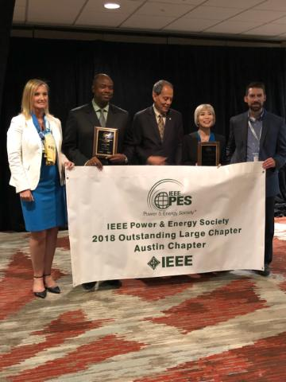
End

